Slide 2
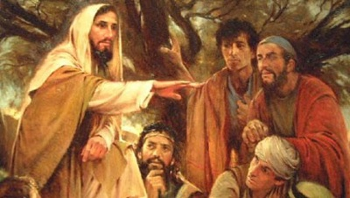
Sermon on the Mount
Matthew 5-7

Slide 3
Sermon
on
the Mount
Matthew 5:33-37
“Cross my heart and hope to die!”
“I swear to God!”
“I swear on my mother’s grave!”
“I swear on a stack of Bibles!”

Slide 4
Sermon
on
the Mount
Matthew 5:33-37
THE LAW ON OATHS
Exodus 20:7 4th commandment – Leviticus 19:12,13
Numbers 30:2,3
PERVERTING THE LAW CONCERNING OATHS
  Matthew 5:33b
  Matthew 5:34-36
  Matthew 23:1-22
  Many Intentionally Perjure Themselves!

Slide 5
Sermon
on
the Mount
Matthew 5:33-37
TWO RULES TO AVOID SUCH SIN FOR CHRISTIANS
  1. Flippant, casual use of God’s name and sacred things
  Exodus 20:7
  People use Euphemisms – Substitute for GOD, Jesus, suchlike
  Jews sinned by casual use of God’s name or names associated with God.

Slide 6
Sermon
on
the Mount
Matthew 5:33-37
TWO RULES TO AVOID SUCH SIN FOR CHRISTIANS
  A Caution for Us: Irreverence & disrespect for sacred things
  “GEE, GEE WHIZ,” Jesus, Jesus Christ
  “Gosh, Golly,” God
  “Gosh Darn,” God Damn
  “OMG!” “Oh My God” (Merriam Webster)

Slide 7
Sermon
on
the Mount
Matthew 5:33-37
TWO RULES TO AVOID SUCH SIN FOR CHRISTIANS
  2. Avoid Perjury – Make a Vow, Promise or Oath
  Keep it!
  An oath means nothing to a liar!
  Matthew 5:37 – Say “YES” and “NO”

Slide 8
Sermon
on
the Mount
Matthew 5:33-37
TWO RULES TO AVOID SUCH SIN FOR CHRISTIANS
  What Jesus DOES NOT FORBID:
  The Making of an Oath in a Court of Law
  Examples of Those who have taken oaths: 2 Corinthians 1:23; Galatians 1:20; Matthew 26:63,64
  Speak Only The Truth – Ephesians 4:25
  James 5:12 “lest you fall into judgment”

